Slide 1
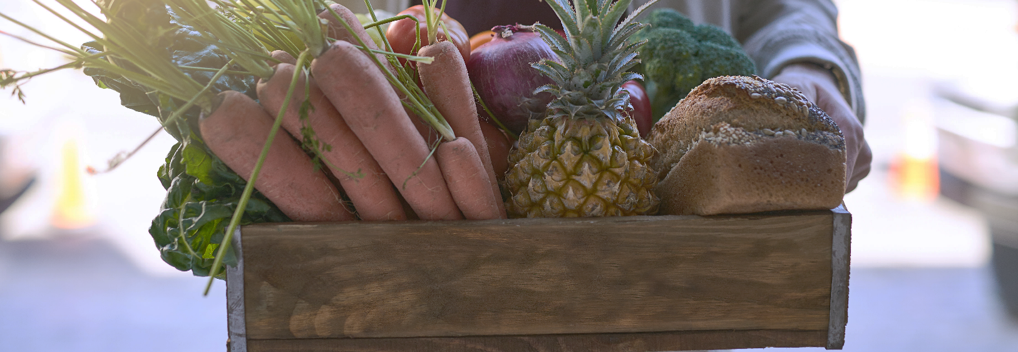

Stratathon April 2025
Stratathon Task Sample Slides
Rotterdam
09/04/2025

Slide 2
Key things to remember while making slides
Slide Making Tips
01
Remember you are presenting to the OC&Grocery board – not all the members will be well-versed in data so make sure you cater to them as well
02
Choose the right visualisations! More data does not always equal better! Feel free to use screenshots from Matplotlib / Seaborn
03
Make sure to explain what is being shown on your slides – use callout boxes, bullet points…
04
Keep the final client question in mind – it should all build towards a final answer!
05
Have fun! Enjoy the process and remember that simple slides sometimes are best!

Slide 3
Headline (main message) – Graph slide
Chart Title (Units) – Describes the graph, e.g. revenue by category
Growth Rate 1
Growth Rate 2
Growth Rate 3

Slide 4
Headline (main message) – Text Slide
Edit Master styles
Second level
Third level

Slide 5
Headline (main message) – Graph & Text Slide
Chart Title (Units) – Describes the graph, e.g. revenue by category
Text
First level
Second level
Third level

Slide 6
Headline (main message) – Text slide
Text
Text
First Level
Second Level
Third Level
First Level
Second Level
Third Level

